Slide 1
Improved Method and Results
Registration of the same region
under different weather conditions
CEG-7550
Logan Back, Chaitanya Appikatla, Sumanth Chappidi

Slide 2
Introduction
The comparative study showed a weak paper
Image Registration based on SIFT Features and Adaptive RANSAC Transform
There is a critical weakness in this paper that does not allow it to register the same region under different weather conditions
Various Methodologies are considered to improve the algorithm
Notes:
SIFT- scale invariant feature transform, its an algorithm that can be used for image registration
RANSAC- RANdom SAmple Consensus- An iterative method to estimate parameters
The combination of these two provide a registration method with a good matching rate

Slide 3
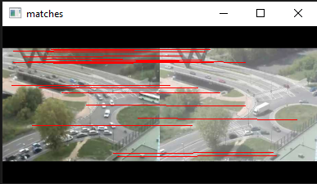

How The Registration Works
The paper uses the SIFT method to extract and match features and the RANSAC algorithm to eliminate mismatches for image registration. The SIFT algorithm detects key points and generates unique descriptors, while the RANSAC algorithm randomly selects data points to fit a model and eliminate mismatches.

Slide 4
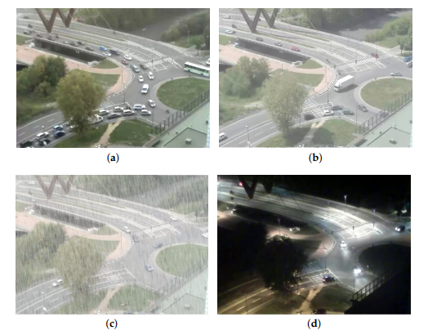
Example Test Images
The paper, Street Viewer: An Autonomous Vision Based Traffic Tracking System, depicts a set of test images from different weather conditions. The paper depicts a clear scene (a), a hazy scene (b), a rainy scene (c), and a dark scene (d). Borrowing these images helps to improve this papers performance because it allows for assessment over how well the system performs in different weather conditions.

Slide 5
Haze Correction Module
The proposed method from Efficient Image Dehazing with Boundary Constraint and Contextual Regularization can remove haze from a single input.
Adding a haze correction module can offer improved reliability, fault tolerance, and real world application. Haze reduces the image quality by reducing contrast and color saturation.
By integrating a haze correction module into the system, images can be automatically corrected to remove haze, resulting in clearer and more vibrant images that can be registered easier and more effectively.
The method utilizes a new constraint on the scene transmission and a contextual regularization method to estimate the unknown transmission of the input image.

Slide 6
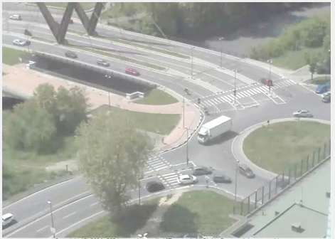
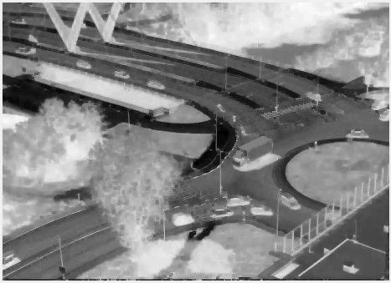
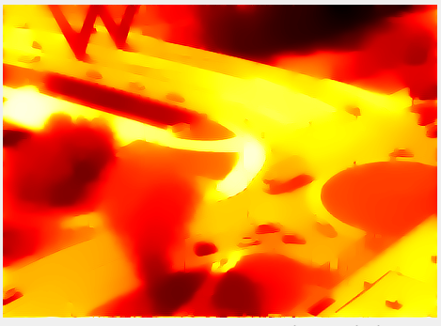
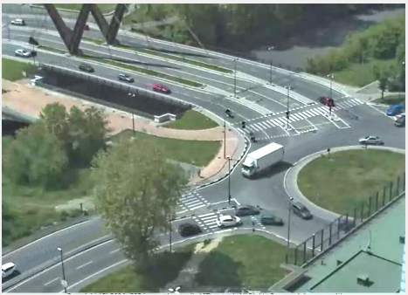
Haze Correction Module Cont.
Input Image
Scene Transmission Estimation- Iteration 6, β = 181, This step is used for fine-tuning the dehazing effects
Recovered transmission function- Gives an estimation of the density map of hazes in the input image
Dehazing Result

Slide 7
Dark Image Correction Module
The proposed method from Adaptive image enhancement method for correcting low-illumination images can improve the adaptability of image enhancement in low illumination images
Dark images can result in reduced image quality and affect the performance of the image processing system. Adding a dark image correction module can improve the reliability, fault tolerance, and real-world application of an image processing system in various ways
By integrating a dark image correction module into the image processing system, dark images can be automatically corrected, leading to improved image quality
A method based on nonlinear functional transformation using illumination-reflection model and multiscale theory extracts an illumination component and uses an image fusion strategy to extract details from two images.

Slide 8
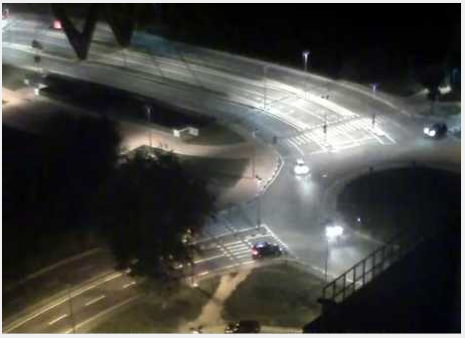
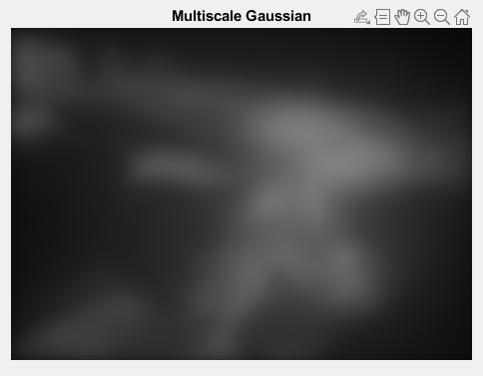
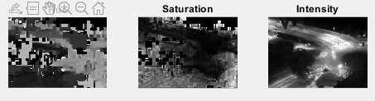
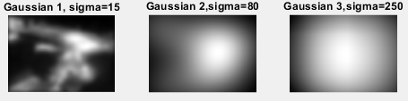
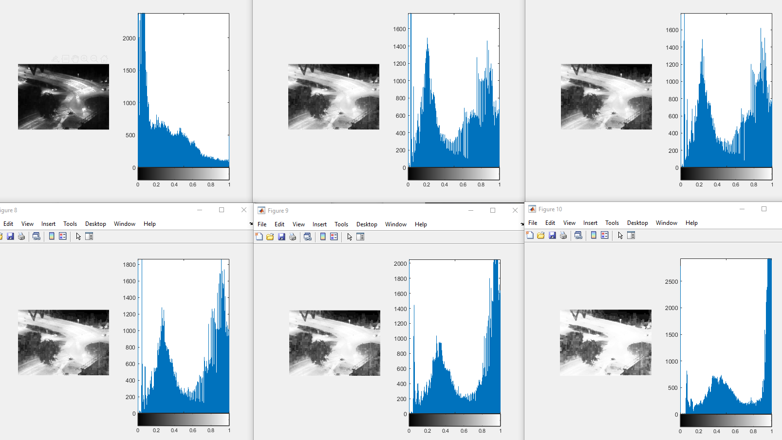
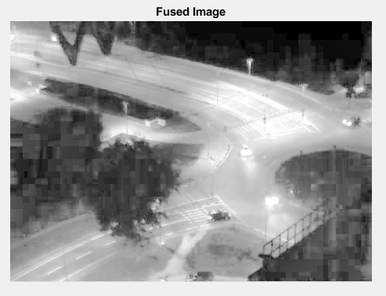
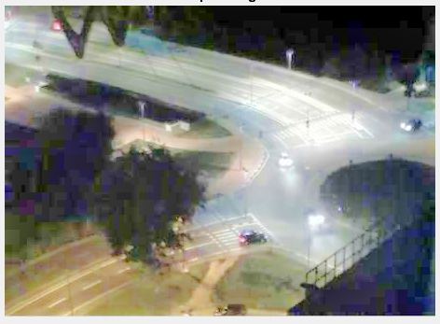
Dark Image Correction Module Cont.

Slide 9
Rainy Image Restoration Module
The proposed method from Single-Image-Based Rain and Snow Removal Using Multi-guided Filter, can remove rain from a single input image.
Adding a rainy image restoration module can improve the reliability, fault tolerance, and real-world application. Rainy weather can reduce image quality by adding unwanted artifacts to the image.
By integrating a rainy image restoration module into the image processing system, rainy images can be automatically corrected, leading to improved image quality and easier and more effective registration.
This method uses the low-frequency part of the image as a guidance image to remove the rain or snow streaks from the high-frequency part using a guided filter.

Slide 10
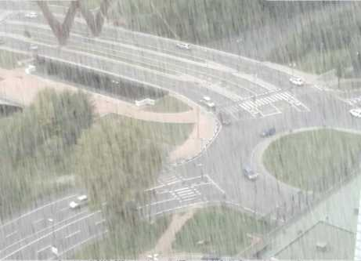
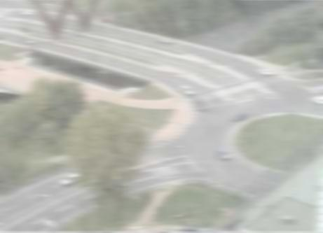
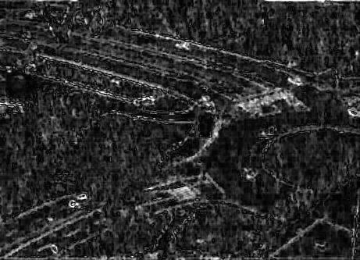
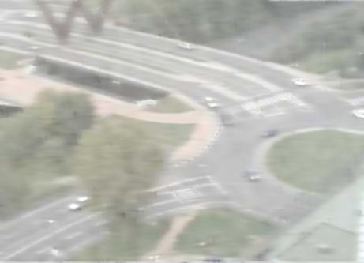
Rainy Image Restoration Module Cont.
Input Image
Low Frequency
High Frequency
Recovered Image

Slide 11
Conclusion
Comparing the two tables, we can see that the values in Table 2 are generally higher than those in Table 1. This suggests that the methodology discussed within Image Registration based on SIFT features and adaptive RANSAC transform have been refined and improved in every resulting category, resulting in better cross-correlation between the images.
Comparisons | Clear | Hazy | Dark | Rainy
Clear | 1 | 0.8886 | 0.3344 | 0.5214
Hazy | 0.8886 | 1 | 0.2261 | 0.8143
Dark | 0.3344 | 0.2261 | 1 | 0.5006
Rainy | 0.5214 | 0.8143 | 0.5006 | 1
Corr. Comparisons | Clear | Hazy | Dark | Rainy
Clear | 1 | 0.9096 | 0.7749 | 0.9426
Hazy | 0.9096 | 1 | 0.5875 | 0.9103
Dark | 0.7749 | 0.5875 | 1 | 0.6976
Rainy | 0.9426 | 0.9103 | 0.6976 | 1

Slide 12
Score Comparisons
Original Score
25 | 3 | 1 | 6 | 6 | 1 | 6 | 5 | 8 | 5 | 5 | 5 | 8 | 0.59
New Score
New | 2 | 6 | 8 | 6 | 8 | 8 | 5 | 8 | 5 | 5 | 5 | 8 | 0.74

Slide 13
References
Z. Hossein-nejad and M. Nasri, "Image registration based on SIFT features and adaptive RANSAC transform," 2016 International Conference on Communication and Signal Processing (ICCSP), Melmaruvathur, India, 2016, pp. 1087-1091, doi: 10.1109/ICCSP.2016.7754318.
Bottino, A.; Garbo, A.; Loiacono, C.; Quer, S. Street Viewer: An Autonomous Vision Based Traffic Tracking System. Sensors 2016, 16, 813. https://doi.org/10.3390/s16060813
G. Meng, Y. Wang, J. Duan, S. Xiang and C. Pan, "Efficient Image Dehazing with Boundary Constraint and Contextual Regularization," 2013 IEEE International Conference on Computer Vision, Sydney, NSW, Australia, 2013, pp. 617-624, doi: 10.1109/ICCV.2013.82.
Wang, Wencheng & Chen, Zhenxue & Yuan, Xiaohui & Wu, Xiaojin. (2019). Adaptive Image Enhancement Method for Correcting Low-Illumination Images. Information Sciences. 496. 10.1016/j.ins.2019.05.015.
Zheng, X., Liao, Y., Guo, W., Fu, X., & Ding, X. (2013). Single-Image-Based Rain and Snow Removal Using Multi-guided Filter. In R. Sun, J. Liu, & X. Zhang (Eds.), Neural Information Processing: 20th International Conference, ICONIP 2013, Proceedings, Part I (pp. 266-273). Lecture Notes in Computer Science, Vol. 8228. Springer. https://doi.org/10.1007/978-3-642-42051-1_33

